Slide 1
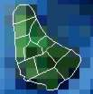
Barbados Society
of
Technologists in Agriculture
Annual Technical Conference
Branded Sugar- one of the ways forward
Barbados Yacht Club Saturday 07 February, 2015

Slide 2
Adding Value to Barbados Sugar
The West Indies Sugar & Trading Company Ltd - a joint venture operation between the Barbados Government (through the Barbados Agricultural Management Company Ltd) and the private sector.

Slide 3
Benefits of Branded Sugar
Adds value to Barbados sugar both in the EU and Caribbean.
Barbados industry receives four times the world price for the sugar , effectively allowing them to make a small profit (rather than a large loss) on each tonne sold under the brand.

Slide 4
Plantation Brand
The creation of the Plantation Brand brings the best of our sugar production to a worldwide audience in a way that
boosts the island’s economy
preserves the environment and
safeguards precious jobs.

Slide 5
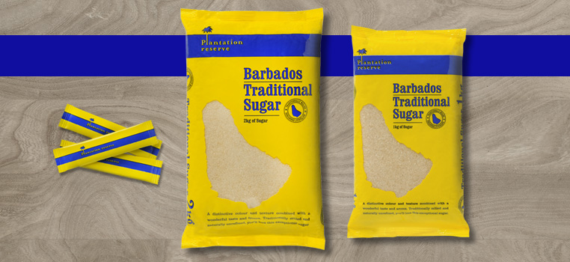
Bags and sachets

Slide 6
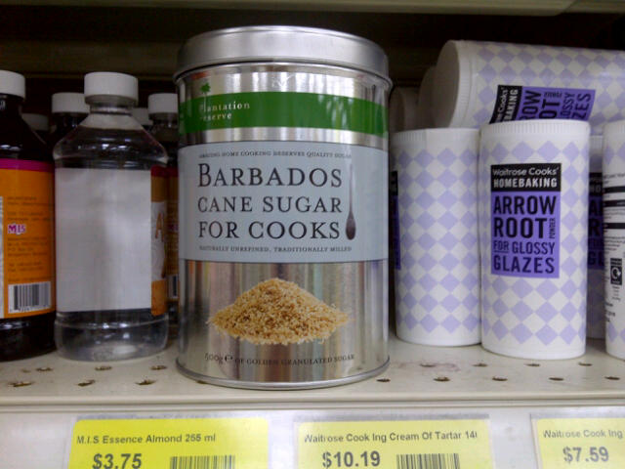
Cans

Slide 7
Comments on Plantation Reserve
Award-winning UK food and wine writer Richard Erlich “There’s a caramel-like sweetness to Plantation Reserve and floral notes of honeysuckle. It also has an excellent persistence of flavour with the taste qualities pleasantly remaining on the palate.”

Slide 8
Comments on Plantation Reserve
Top food writer Joanna Blythman described Plantation Reserve as being “a unique, straw-coloured sugar with large, sparkling crystals. Stick your nose in a tin and you inhale the most remarkable butterscotch-and-fudge aroma”.

Slide 9
2015 crop
West Indies Sugar and Trading Company will take all the direct consumption sugar produced at Portvale– around 4000 tonnes
Bags and sachets being produced

Slide 10
Potential New markets for Sugar
China
South Korea
Hong Kong
Vietnam
Singapore

